Slide 1
Pre-read
Introduction to Time Series
Intro Video: https://www.youtube.com/watch?v=GUq_tO2BjaU
DA 230 Textbook Sections: 12.1 – 12.2
(Optional) Forecasting: Principles and Practice (2nd ed): Rob J Hyndman and George Athanasopoulos
Chapter 1: https://otexts.com/fpp2
Chapter 6.1: https://otexts.com/fpp2/components.html
Chapter 5.1 – 5.4: https://otexts.com/fpp2/regression.html

Slide 2
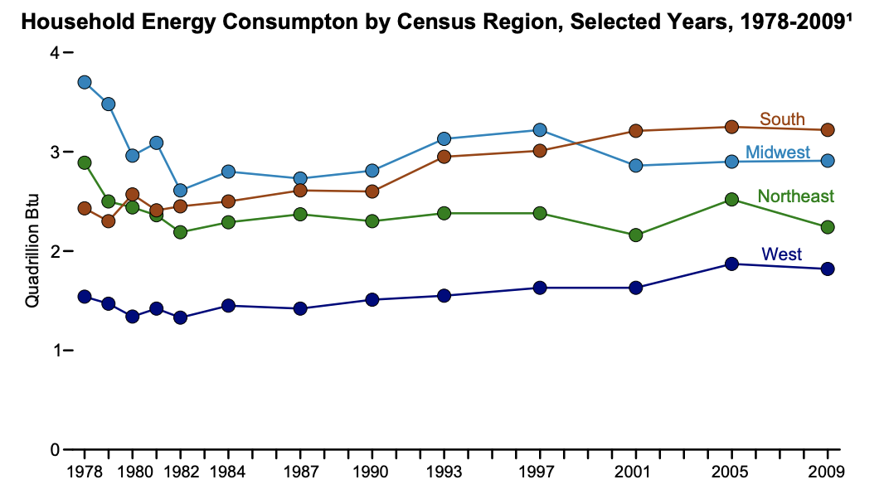
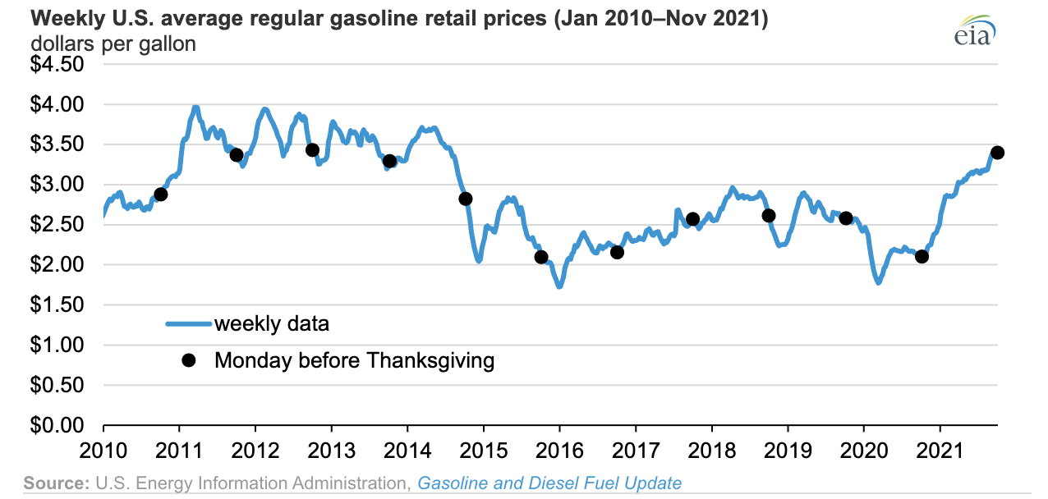
What benefits you would gain by knowing the future?
Future Planning
Budgeting
Source: US Energy Information Administration

Slide 3
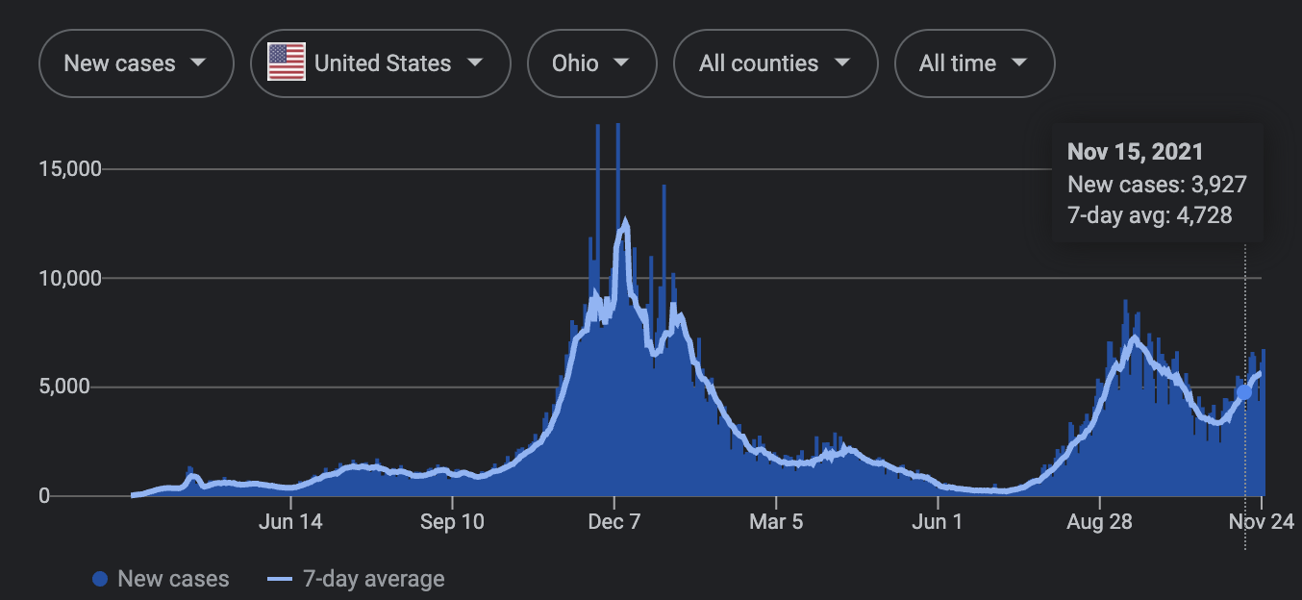
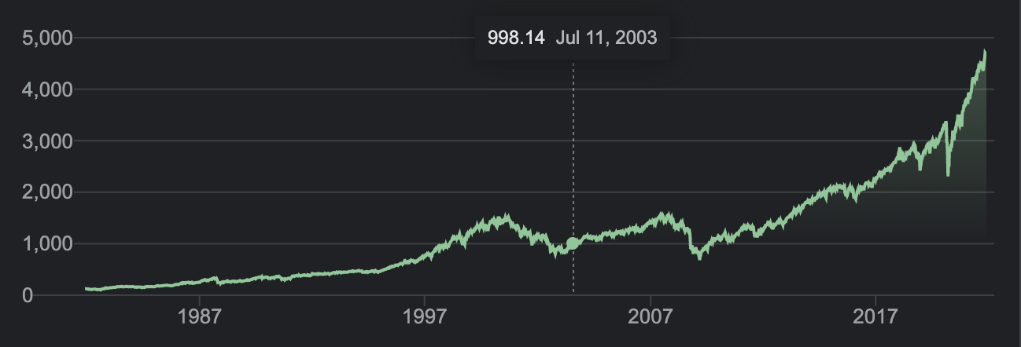
What benefits you would gain by knowing the future?
Understand future trends
Establish preventive tasks
COVID Cases in Ohio
S&P 500 Share Prices
Source: Google Finance
Source: New York Times

Slide 4
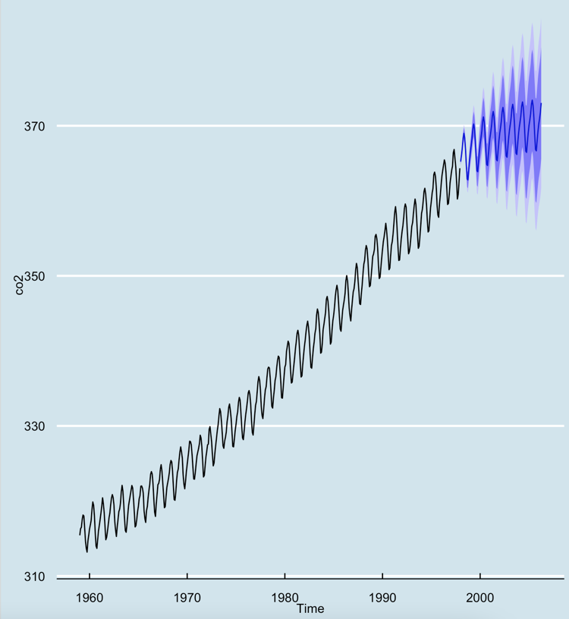
Introduction to Time Series
Lochana Palayangoda, PhD
December 7, 2021

Slide 5
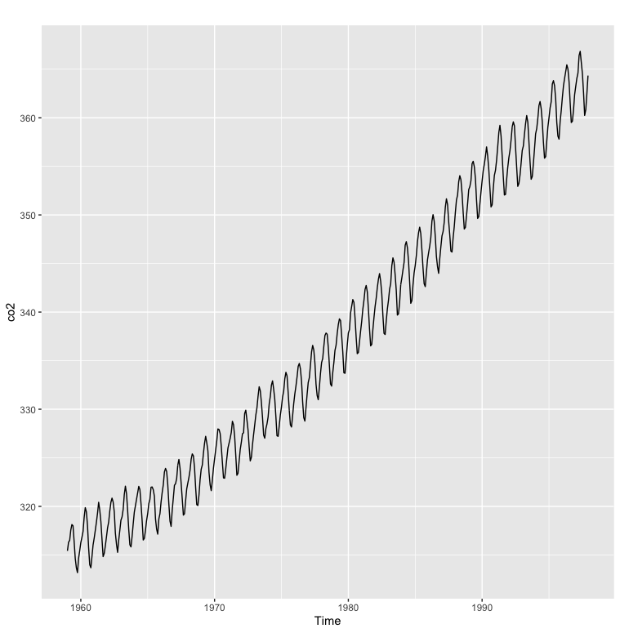
Time Series is a set of measurements taken at regular intervals over periods of time
Weekly Gas prices
Annual energy consumption
Daily share prices
Monthly COVID19 cases in Ohio
The measurements may be taken every hour, day, week, month, quarter, year, or at any other regular time interval
Usually, time series data are taken in similar time intervals
Atmospheric concentrations of CO2 are expressed in parts per million (ppm) and reported in the preliminary 1997 SIO manometric mole fraction scale.

Slide 6
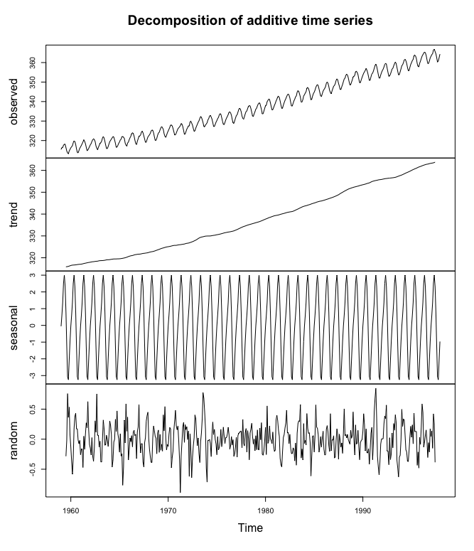
Time Series Decomposition
co2 data set has monthly data from 1959 to 1997 which has 468 records
Trend: up and down movements (usually long term)
Seasonal: repetition of same pattern over specific period
Random: irregular component in time series
Cyclic: long term trends or ups and downs that are not of fixed period (e.g., business cycles, COVID waves)

Slide 7
Time Series Decomposition
Decomposition help us to identify trends, seasonality and random components in the time series
We can update our time series model to reflect each component
library(forecast)
decom = decompose(co2)
plot(decom)
Notes:
### R Code for Time Series Decomposition ###
# Install “forecast” package if it is not already installed
if(!require(forecast)){install.packages("forecast")}
# Library for time series modeling
library(forecast)
# Time series decomposition function in R applied for co2 data set
decom = decompose(co2)
# Plot the decomposition of the co2 time series data
plot(decom)

Slide 8
Today’s class we mainly cover Regression-based Time Series methods
Regression-based Models
Trend Forecast
Seasonal Forecast
Trend + Seasonal Forecast
Important Concepts for Further Studies
Autocorrelation
Stationarity
ACF Plots

Slide 9
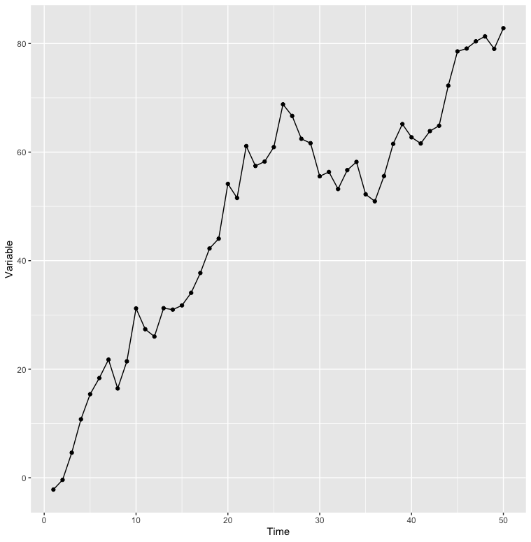
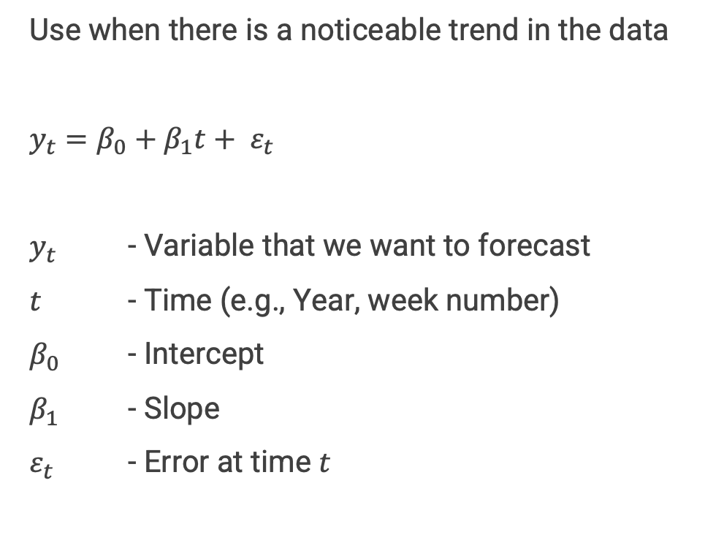
Trend Forecast
Regression-based Methods
Use when there is a noticeable trend in the data
$y_{t}=β_{0}+β_{1}t+ ε_{t}$
$y_{t}$ - Variable that we want to forecast
$t$ - Time (e.g., Year, week number)
$β_{0}$ - Intercept
$β_{1}$ - Slope
$ε_{t}$ - Error at time $t$

Slide 10
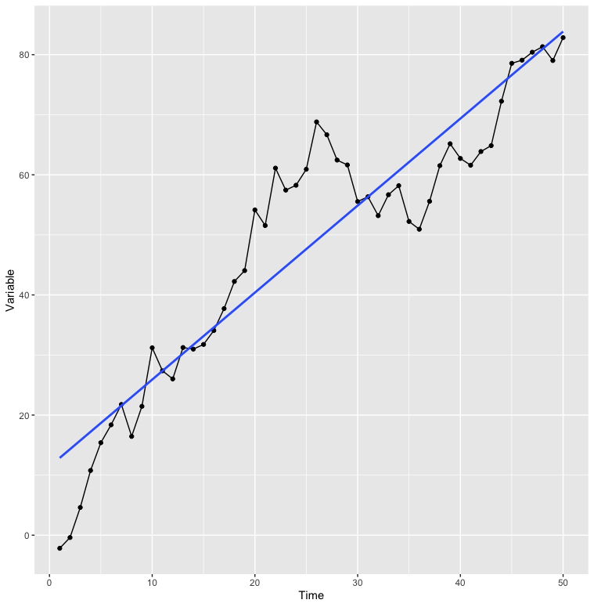
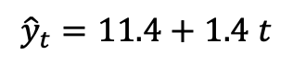
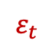
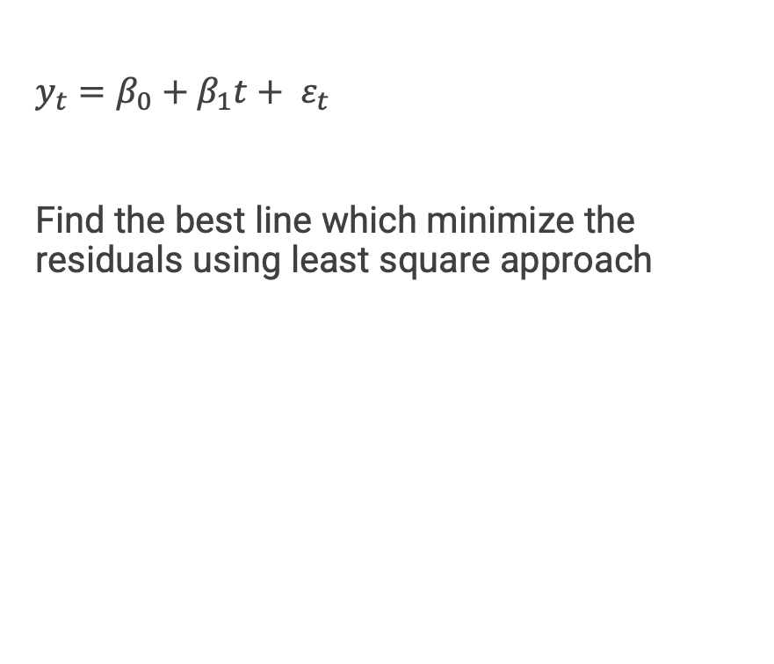
Trend Forecast
Regression-based Methods
$y_{t}=β_{0}+β_{1}t+ ε_{t}$
Find the best line which minimize the residuals using least square approach
$$ε_{t}$$
$${\hat{y}}_{t}=11.4+1.4 t$$

Slide 11
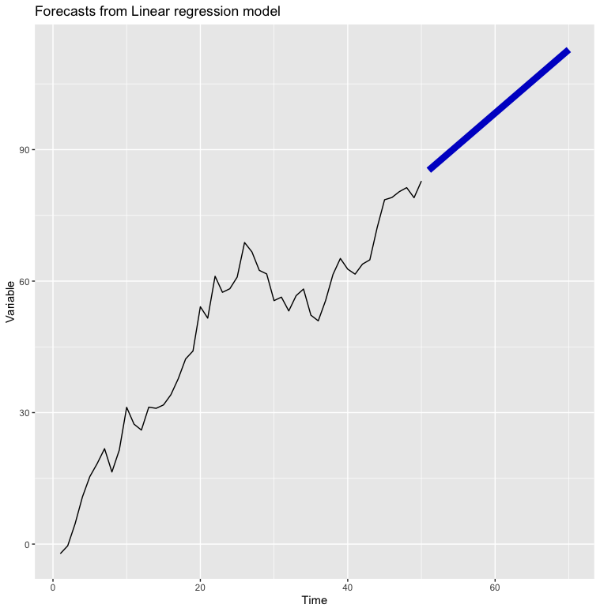
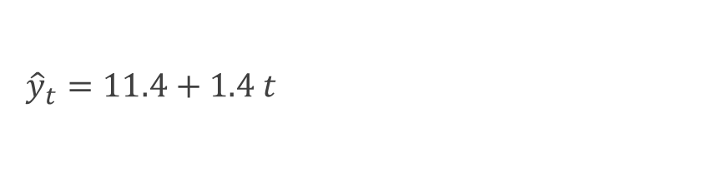
Trend Forecast
Regression-based Methods
Forecast
${\hat{y}}_{t}=11.4+1.4 t$
Create Time Series Object
Apply model
Forecast
object=
ts(data,
start,
end,
frequency)
model=
tslm(object)
forecast(model, h)
Notes:
### Trend Forecast: R Code with comments ###
if(!require(forecast)){install.packages(“forecast")}
if(!require(ggplot2)){install.packages("ggplot2")}
# Forecast Library for time series
library(forecast)
# ggplot2 Library for plotting
library(ggplot2)
# Set the seed for random data generation so we all have same results
set.seed(41)
# Generate random data using Brownian Motion with positive drift
Variable = cumsum(rnorm(n = 50,mean = 1,sd = 4))
# Convert the random data to a R Time Series Object
Variable = ts(Variable, frequency=1)
# Model with Linear Trend Model
linear_lm = tslm(Variable ~ trend)
# Summary of the model
summary(linear_lm)
# Forecast for next 20 time points
forecast_lm = forecast(linear_lm, h = 20)
# Plot the time series with forecast
autoplot(forecast_lm, PI=F, flwd=3)

Slide 12
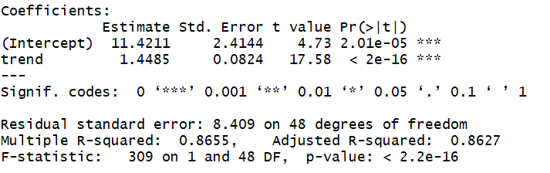

Trend Forecast
${\hat{y}}_{t}=11.4+1.4 t$
Regression-based Methods
Forecast
# Generate random data using Brownian Motion with positive drift
Variable = cumsum(rnorm(n = 50,mean = 1,sd = 4))
# Convert the random data to a R Time Series Object
Variable = ts(Variable, frequency=1)
# Model with Linear Trend Model
linear_lm = tslm(Variable ~ trend)
# Summary of the model
summary(linear_lm)
# Forecast for next 20 time points
forecast_lm = forecast(linear_lm, h = 20)
# Plot the time series with forecast
autoplot(forecast_lm, PI=F, flwd=3)
Notes:
### Trend Forecast: R Code with comments ###
if(!require(forecast)){install.packages(“forecast")}
if(!require(ggplot2)){install.packages("ggplot2")}
# Forecast Library for time series
library(forecast)
# ggplot2 Library for plotting
library(ggplot2)
# Set the seed for random data generation so we all have same results
set.seed(41)
# Generate random data using Brownian Motion with positive drift
Variable = cumsum(rnorm(n = 50,mean = 1,sd = 4))
# Convert the random data to a R Time Series Object
Variable = ts(Variable, frequency=1)
# Model with Linear Trend Model
linear_lm = tslm(Variable ~ trend)
# Summary of the model
summary(linear_lm)
# Forecast for next 20 time points
forecast_lm = forecast(linear_lm, h = 20)
# Plot the time series with forecast
autoplot(forecast_lm, PI=F, flwd=3)

Slide 13
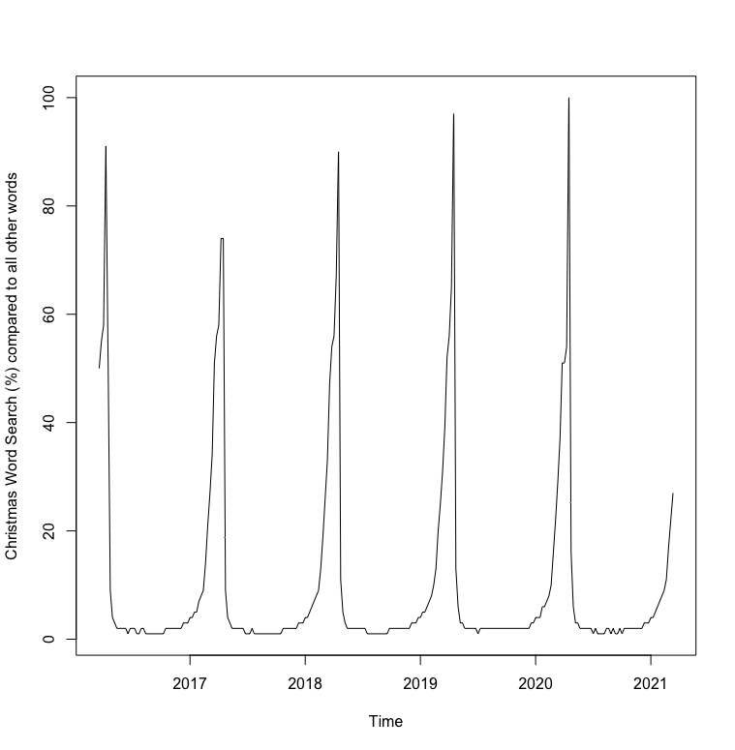
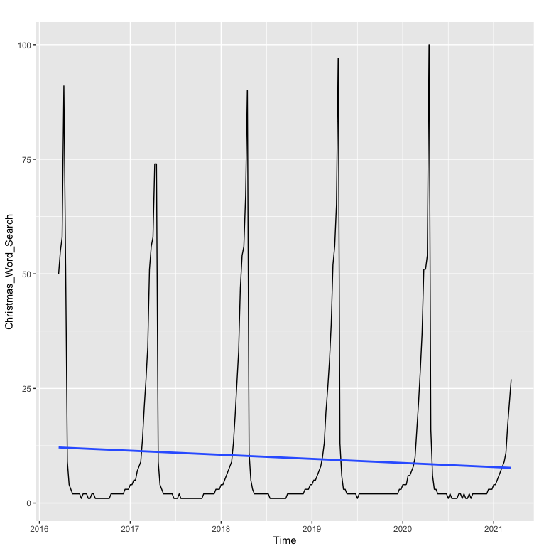
Seasonal Forecast
Monthly data for the word search “Christmas” for last 5 years
Regression-based Methods
Use when there is a periodic patterns in time series
Quartey (Period = 4)
Monthly (Period =12)
Weekly (Period = 52)
Method 1: Seasonal Mean Model
Method 2: Cosine Trend Model

Slide 14
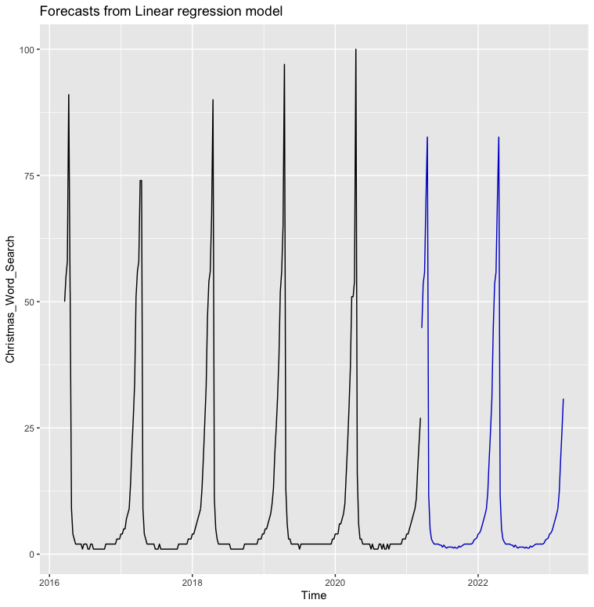
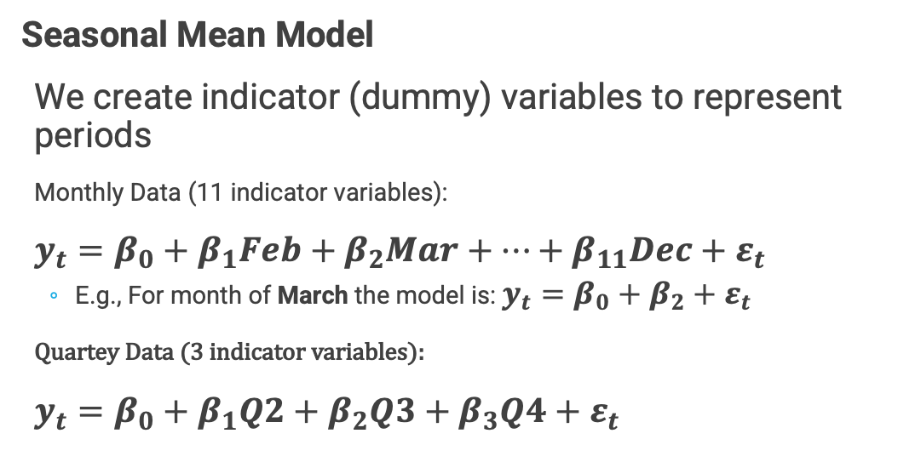
Seasonal Forecast
Weekly data for the word search “Christmas” for last 5 years
Regression-based Methods
Seasonal Mean Model
We create indicator (dummy) variables to represent periods
Monthly Data (11 indicator variables):
$y_{t}=β_{0}+β_{1}Feb+β_{2}Mar+…+β_{11}Dec+ε_{t}$
E.g., For month of March the model is: $y_{t}=β_{0}+β_{2}+ε_{t}$
Quartey Data (3 indicator variables):
$y_{t}=β_{0}+β_{1}Q2+β_{2}Q3+β_{3}Q4+ε_{t}$
# See Note for code comments
season_lm = tslm(Christmas_Word_Search ~ season)
forecast_christmas = forecast(season_lm,h=104)
autoplot(forecast_christmas,PI=F)
Notes:
###Seasonal Forecast: R Code###
#Christmas word search data from Google Trends
Christmas_Word_Search = c(50, 55, 58, 91, 52, 9, 4, 3, 2, 2, 2, 2, 2, 1, 2, 2, 2, 1, 1, 2, 2, 1, 1, 1, 1, 1, 1, 1, 1, 1, 2, 2, 2, 2, 2, 2, 2, 2, 3, 3, 3, 4, 4, 5, 5, 7, 8, 9, 14, 21, 27, 34, 51, 56, 58, 74, 74, 9, 4, 3, 2, 2, 2, 2, 2, 2, 1, 1, 1, 2, 1, 1, 1, 1, 1, 1, 1, 1, 1, 1, 1, 1, 1, 2, 2, 2, 2, 2, 2, 2, 3, 3, 3, 4, 4, 5, 6, 7, 8, 9, 13, 19, 26, 33, 47, 54, 56, 67, 90, 11, 5, 3, 2, 2, 2, 2, 2, 2, 2, 2, 2, 1, 1, 1, 1, 1, 1, 1, 1, 1, 1, 2, 2, 2, 2, 2, 2, 2, 2, 2, 2, 3, 3, 3, 4, 4, 5, 5, 6, 7, 8, 10, 13, 20, 25, 31, 39, 52, 56, 65, 97, 13, 6, 3, 3, 2, 2, 2, 2, 2, 2, 1, 2, 2, 2, 2, 2, 2, 2, 2, 2, 2, 2, 2, 2, 2, 2, 2, 2, 2, 2, 2, 2, 2, 2, 3, 3, 4, 4, 4, 6, 6, 7, 8, 10, 16, 22, 29, 37, 51, 51, 54, 100, 16, 6, 3, 3, 2, 2, 2, 2, 2, 2, 1, 2, 1, 1, 1, 1, 2, 2, 1, 2, 1, 1, 2, 1, 2, 2, 2, 2, 2, 2, 2, 2, 2, 3, 3, 3, 4, 4, 5, 6, 7, 8, 9, 11, 17, 22, 27)
# Convert the data to R Time Series object (Here frequency is 52 since we have weekly data over 5 years)
Christmas_Word_Search = ts(Christmas_Word_Search,start = c(2016,12),end = c(2021,11),frequency = 52)
# Model for seasons
season_lm = tslm(Christmas_Word_Search ~ season)
# Summary of the model
summary(season_lm)
# Forecast for next 2 years: (i.e., 104 weeks for 2 years)
forecast_christmas = forecast(season_lm,h=104)
#Plot the forecast data
autoplot(forecast_christmas,PI=F)

Slide 15
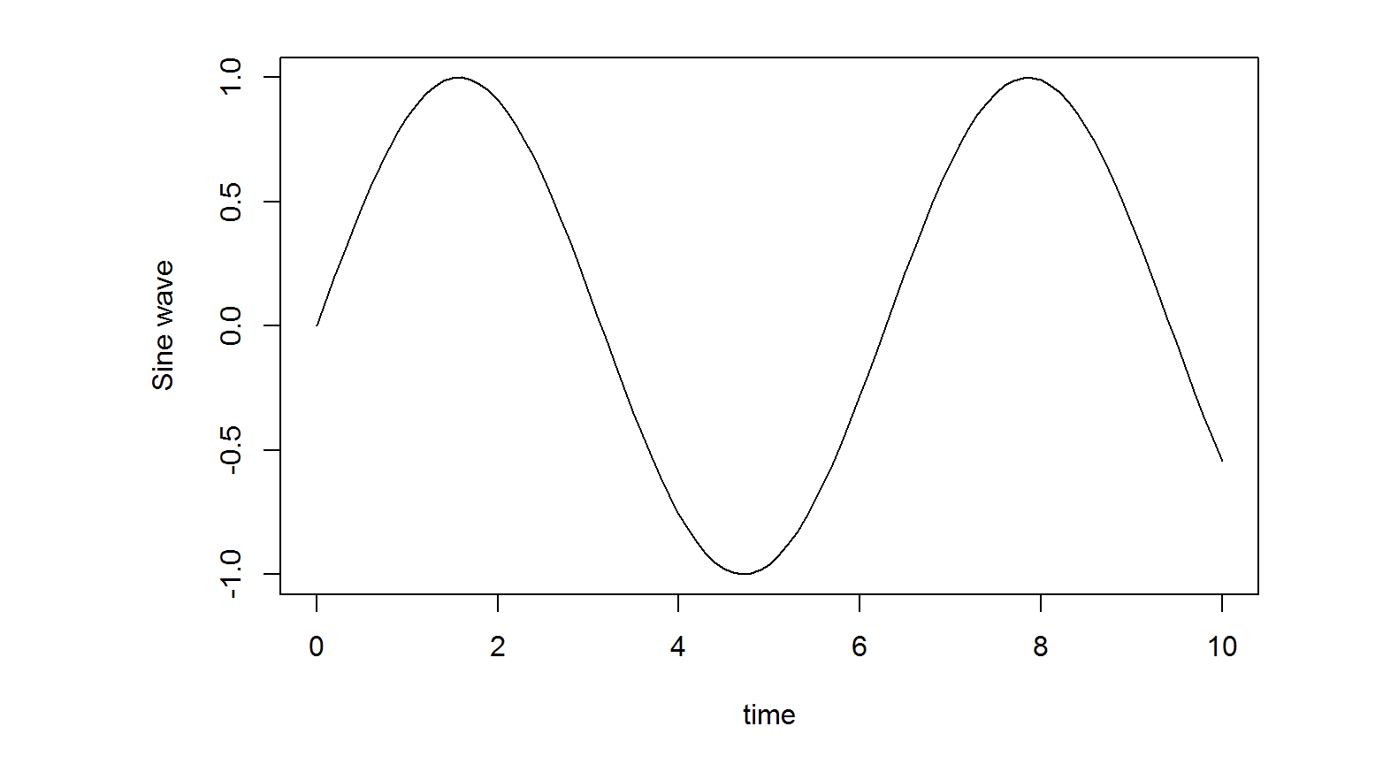
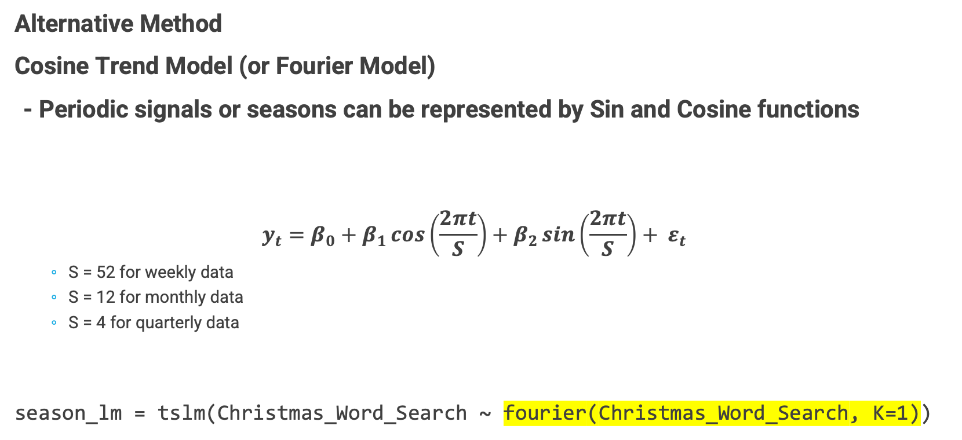
Seasonal Forecast
Regression-based Methods
Alternative Method
Cosine Trend Model (or Fourier Model)
- Periodic signals or seasons can be represented by Sin and Cosine functions
$$y_{t}=β_{0}+β_{1}\cos\left(\frac{2πt}{S}\right)+β_{2}\sin\left(\frac{2πt}{S}\right)+ ε_{t}$$
S = 52 for weekly data
S = 12 for monthly data
S = 4 for quarterly data
season_lm = tslm(Christmas_Word_Search ~ fourier(Christmas_Word_Search, K=1))

Slide 16
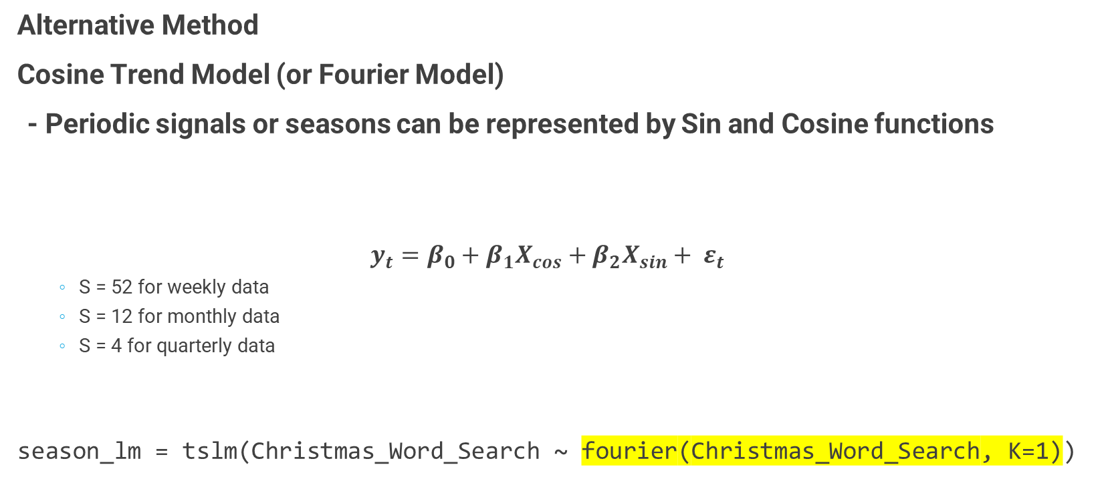
Seasonal Forecast
Regression-based Methods
Alternative Method
Cosine Trend Model (or Fourier Model)
- Periodic signals or seasons can be represented by Sin and Cosine functions
$$y_{t}=β_{0}+β_{1}X_{cos}+β_{2}X_{sin}+ ε_{t}$$
S = 52 for weekly data
S = 12 for monthly data
S = 4 for quarterly data
season_lm = tslm(Christmas_Word_Search ~ fourier(Christmas_Word_Search, K=1))

Slide 17
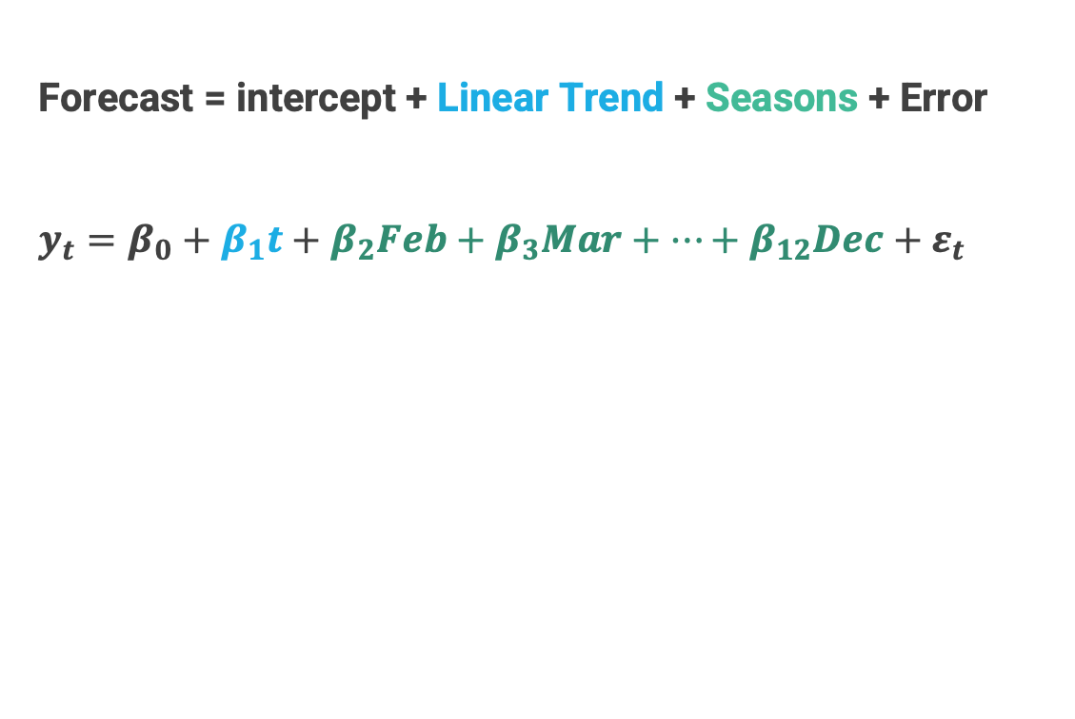
Trend + Seasonal Forecast
Regression-based Methods
Forecast = intercept + Linear Trend + Seasons + Error
$y_{t}=β_{0}+β_{1}t+β_{2}Feb+β_{3}Mar+…+β_{12}Dec+ε_{t}$
Monthly CO₂ data

Slide 18
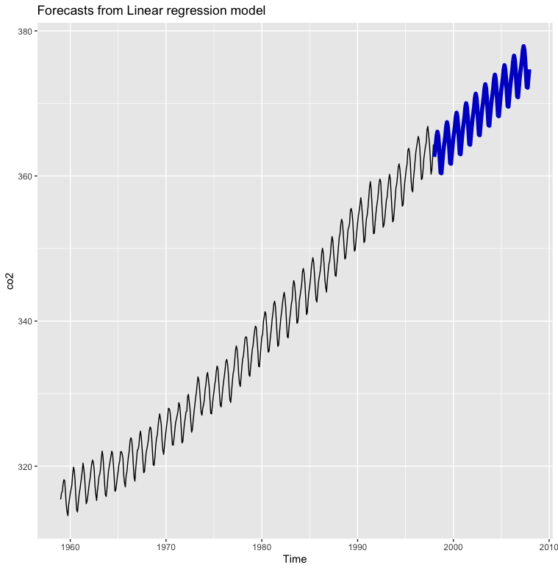
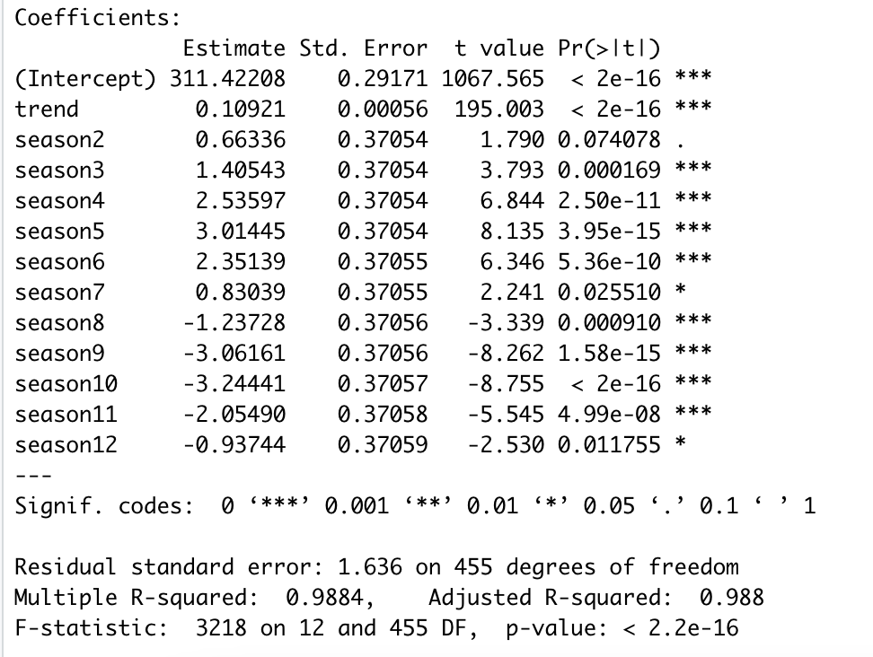
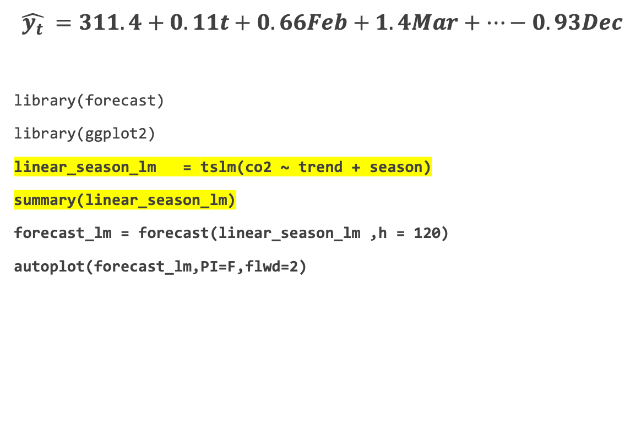
Trend + Seasonal Forecast
Regression-based Methods
$\hat{y_{t}} =311.4+0.11t+0.66Feb+1.4Mar+…−0.93Dec$
library(forecast)
library(ggplot2)
linear_season_lm = tslm(co2 ~ trend + season)
summary(linear_season_lm)
forecast_lm = forecast(linear_season_lm ,h = 120)
autoplot(forecast_lm,PI=F,flwd=2)
Notes:
###Trend+Seasonal Forecast: R Code###
# Include required libraries if they are not already loaded
library(forecast)
library(ggplot2)
# Model for Trend + Seasons (season mean model)
linear_season_lm = tslm(co2 ~ trend + season)
# Summary of the model
summary(linear_season_lm)
# Forecast for next 120 months
forecast_lm = forecast(linear_season_lm ,h = 120)
autoplot(forecast_lm,PI=F,flwd=2)

Slide 19
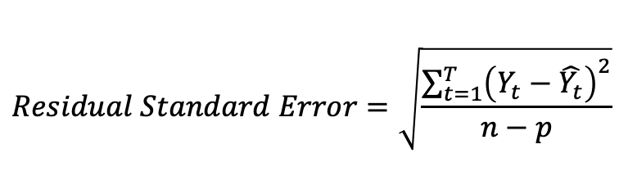
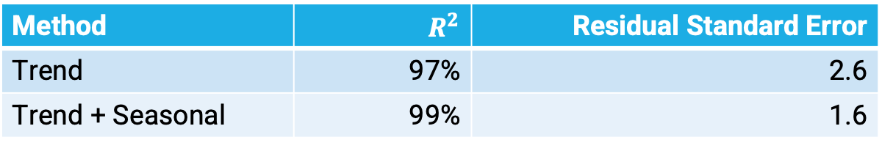
Evaluation of Regression Based Methods for CO2 data
Method | $$R^{2}$$ | Residual Standard Error
Trend | 97% | 2.6
Trend + Seasonal | 99% | 1.6
$R^{2}$ - Coefficient of Determination
e.g., 99% of co2 emission variation is explained by the trend and seasonal factors
$$Residual Standard Error=\sqrt{\frac{{\sum_{t=1}^{T}{\left(Y_{t}−\hat{Y_{t}}\right)}}^{2}}{n−p}}$$
$p$ – number of parameters
e.g., Trend + Season model for co2 data set p = 13 (Intercept + Slope + 11 Indicator Variables)

Slide 20
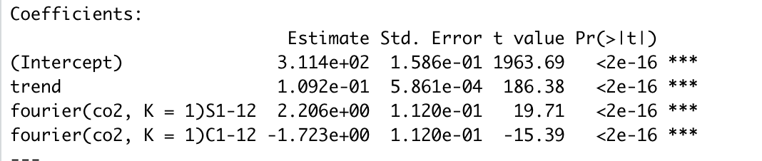
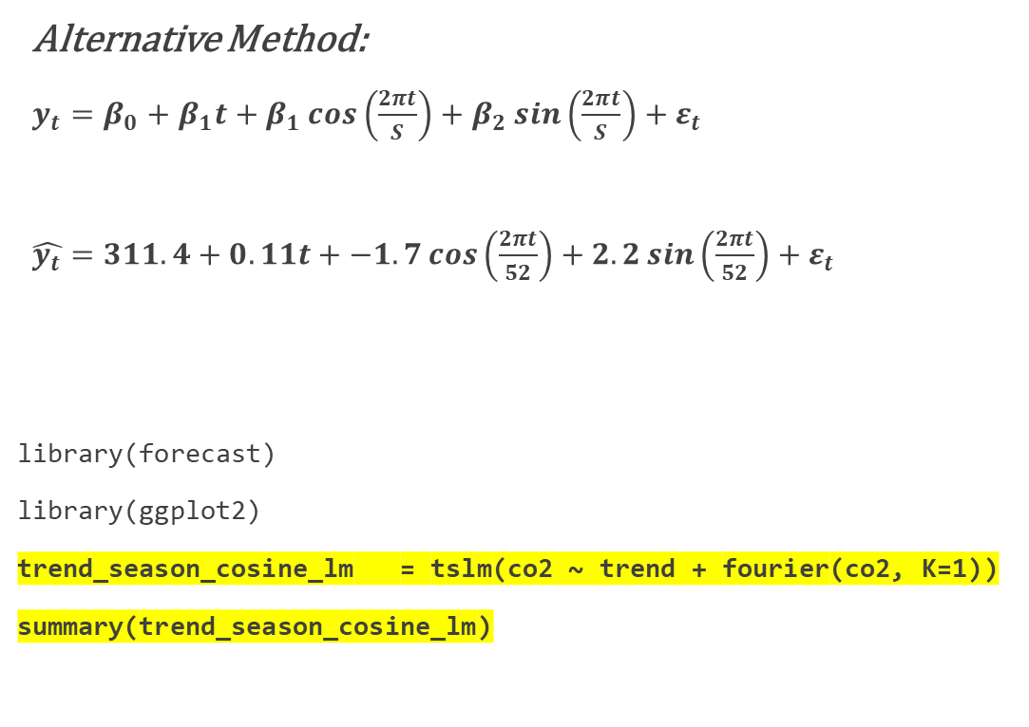
Trend + Seasonal Forecast
Regression Methods
Alternative Method:
$y_{t}=β_{0}+β_{1}t+β_{1}\cos\left(\frac{2πt}{S}\right)+β_{2}\sin\left(\frac{2πt}{S}\right)+ε_{t}$
$\hat{y_{t}}=311.4+0.11t+−1.7\cos\left(\frac{2πt}{52}\right)+2.2\sin\left(\frac{2πt}{52}\right)+ε_{t}$
library(forecast)
library(ggplot2)
trend_season_cosine_lm = tslm(co2 ~ trend + fourier(co2, K=1))
summary(trend_season_cosine_lm)

Slide 21
Regression methods are convenient, but they also have drawbacks
Benefits:
- Convenient to model
- Flexible to add multiple factors which influence our response in addition to time
Drawbacks:
- Extrapolation is not recommended in regression
- Works only with data with trends and seasonality
- Random error in time series data is not independent
- Not account for autocorrelations

Slide 22
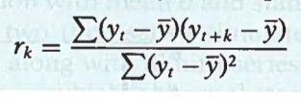
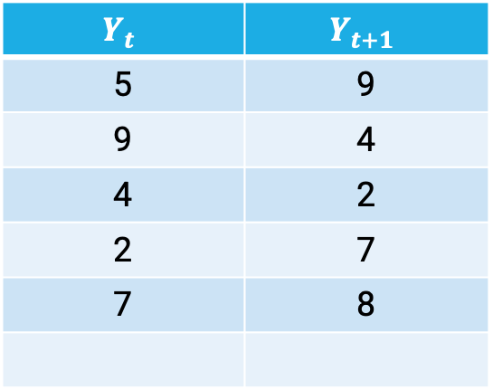
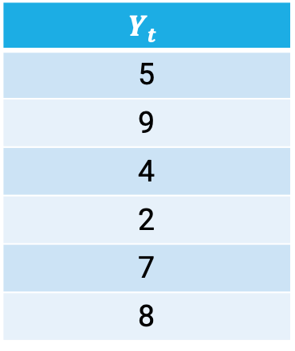
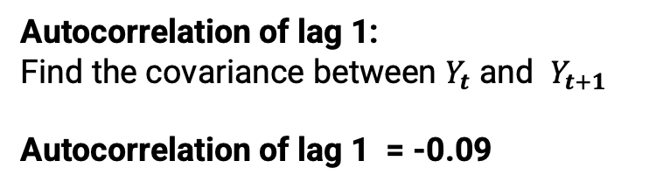
Autocorrelation
Measuring Dependence on Past Values
Correlation measure the linear-relationship between two random variables
Autocorrelation measure the linear-relationship within a random variable with “lags”
$$Y_{t}$$
5
9
4
2
7
8
$$Y_{t}$$ | $$Y_{t+1}$$
5 | 9
9 | 4
4 | 2
2 | 7
7 | 8
Autocorrelation of lag 1:
Find the covariance between $Y_{t}$ and $Y_{t+1}$
Autocorrelation of lag 1 = -0.09

Slide 23
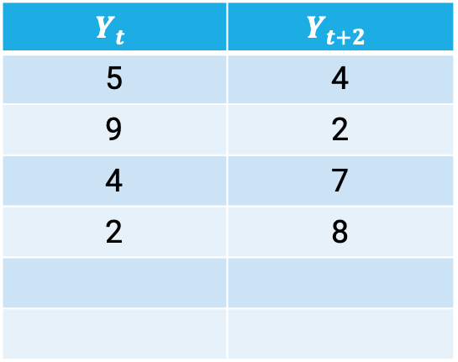
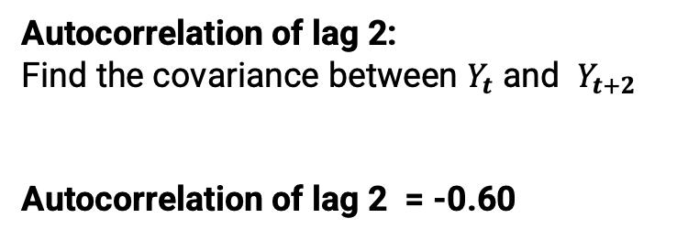
Autocorrelation
Measuring Dependence on Past Values
Correlation measure the linear-relationship between two random variables
Autocorrelation measure the linear-relationship within a random variable with “lags”
$$Y_{t}$$
5
9
4
2
7
8
$$Y_{t}$$ | $$Y_{t+2}$$
5 | 4
9 | 2
4 | 7
2 | 8
Autocorrelation of lag 2:
Find the covariance between $Y_{t}$ and $Y_{t+2}$
Autocorrelation of lag 2 = -0.60

Slide 24
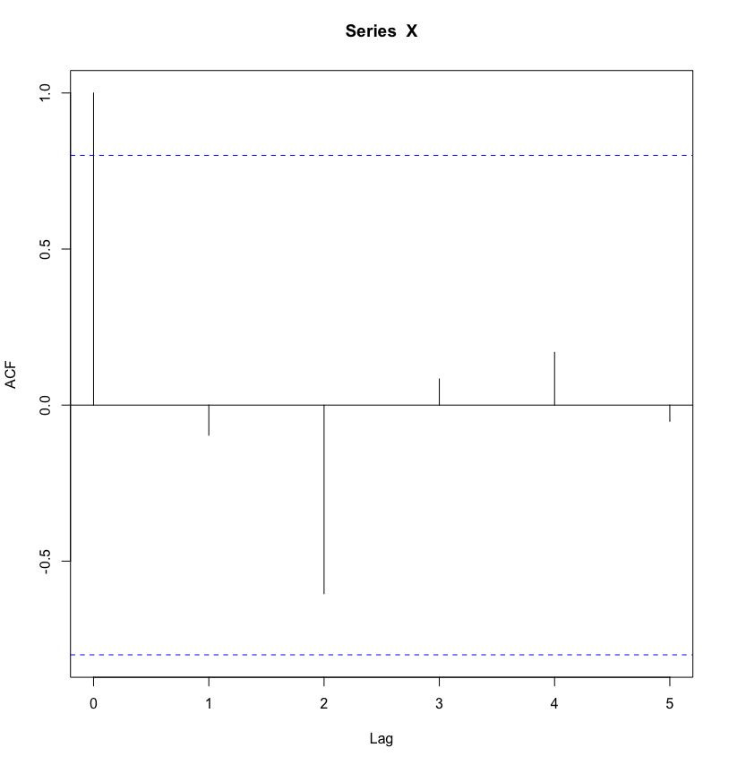
Autocorrelation Plot
Lag 0 autocorrelation is always 1
R code to obtain the autocorrelation plot
Y = c(5, 9, 4, 2, 7, 8)
autocorrelation = acf(Y)
autocorrelation$acf
ACF Plots are used to determine the time series models in Autoregression approach
Above these boundaries the autocorrelations are significant
Notes:
Y = c(5, 9, 4, 2, 7, 8)
# R function to get autocorrelation values and plot
autocorrelation = acf(Y)
autocorrelation$acf

Slide 25
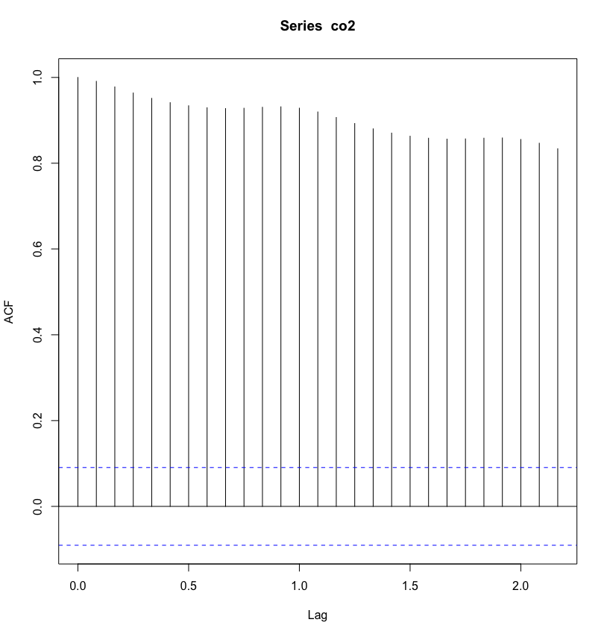
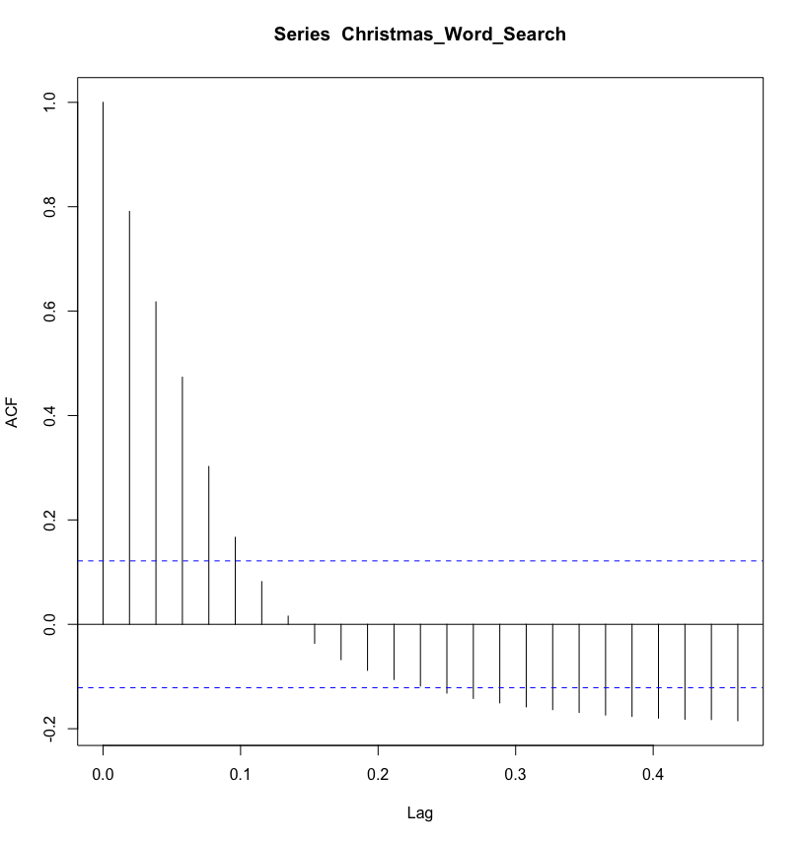
Autocorrelation Plots
Data set use in this lecture
acf(co2)
acf(Christmas_Word_Search)

Slide 26
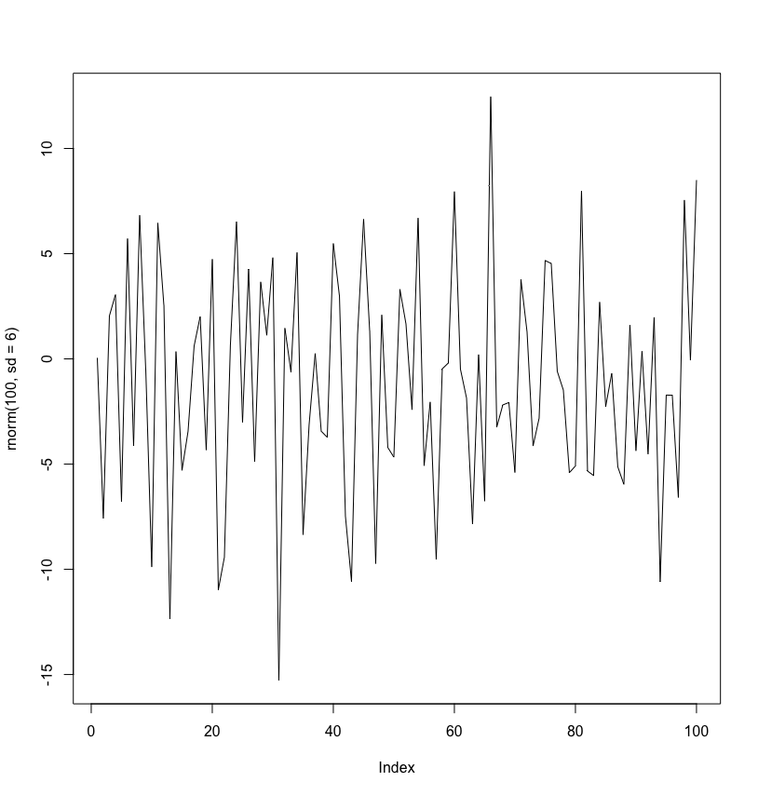
Stationarity
Time series is said to be Stationary when its statistical properties (mean, variance, etc) don’t change over time
→ Time series with trends or seasons are not stationary
Not Stationary
Not Stationary
Stationary

Slide 27
Stationarity
Often, the differences (lags) of a time series are stationary. (But sometimes you need to take more than one difference.)
→ And you may still have autocorrelations!
X
Not Stationary
Stationary?
Notes:
## Differences:
diff(co2) #lag=1 is default
diff(co2, lag=2) #to get other lags, use ‘lag’ argument
autoplot(diff(co2), main ="Differences (lag=1) of CO2 time series")
#Still significant autocorrelation in the differenced series (seasonality)
acf(diff(co2))
#Try to difference out the seasonality…
acf(diff(diff(diff(co2,lag=1),lag=6),lag=12))

Slide 28
More Time Series Techniques
Smoothing Techniques (Moving Average, Exponential Smoothing)
https://otexts.com/fpp2/moving-averages.html
https://otexts.com/fpp2/expsmooth.html
AutoRegressive Integrated Moving Average (ARIMA) Models
Textbook Section 12.3
https://otexts.com/fpp2/arima.html
Prophet
https://facebook.github.io/prophet/docs/quick_start.html#r-api
Recurrent Neural Network with LSTM
https://builtin.com/data-science/recurrent-neural-networks-and-lstm

